Slide 1
creating a photography site using Html5 - m. sai Dheeraj 5a6 - m, sai ratnakar 5c5

Slide 2
contents:
Abstract
Introduction
Technologies used
Page contents
Resources
conclusion

Slide 3
Abstract
We rarely really take the time to see the many miracles and hidden universes that are constantly presented to us. In this sense, photography has been a gift of 'sight' in that it has helped me to slow down and to engage my senses on a much deeper level than ever before.
By using (PIXEL’s) we can connect The world of photography to Reality and enjoy the slight, perceptions, creativity of Modern world photography.

Slide 4
Introduction
Our Photography-site (PIXEL’s) connects photographer works to clients and leads us wherever your creative path takes us. This website can be used for viewing/saving photography works of photographers online.

Slide 5
technologies used:
HYPER TEXT MARKUP LANGUAGE(HTML):
HTML is the standard markup language for documents designed to be displayed in a web browser. It can be assisted by technologies such as Cascading Style Sheets(CSS) and scripting languages such as Java Script.
CASCADING STYLE SHEETS(CSS):
Cascading Style Sheets (CSS) is a style sheet language used for describing the presentation of a document written in a markup language such as HTML.CSS is a cornerstone technology of the World Wide Web, alongside HTML and JavaScript.
JAVASCRIPT(JS):
JavaScript(JS) is a programming language that conforms to the ECMAScript specification .JavaScript is high-level, often just-in-time compiled, and multi-paradigm. It has curly-bracket syntax, dynamic typing, prototype-based object-orientation, and first-class functions.

Slide 6
Html-5
HTML stands for Hyper Text Markup Language, It is the standard markup language for creating Web pages. HTML describes the structure of a Web page. It consists of a series of elements. It elements tell the browser how to display the content. It elements label pieces of content such as "this is a heading", "this is a paragraph", "this is a link", etc.
Basics tags to know about HTML5:
The <!DOCTYPE html> declaration defines that this document is an HTML5 document.
The <html> element is the root element of an HTML page.
The <head> element contains meta information about the HTML page.
The <title> element specifies a title for the HTML page (which is shown in the browser's title bar or in the page's tab).
The <body> element defines the document's body, and is a container for all the visible contents, such as headings, paragraphs, images, hyperlinks, tables, lists, etc.
The <h1> element defines a large heading.
The <p> element defines a paragraph.

Slide 7
CSS & javascript
CSS is the language we use to style an HTML document. CSS describes how HTML elements should be displayed.
JavaScript is the world's most popular programming language. It is the programming language of the Web. It is easy to learn.
Example for JS:
<!DOCTYPE html>
<html>
<body>
<h2>My First JavaScript</h2>
<button type="button"
onclick="document.getElementById('demo').innerHTML = Date()">
Click me to display Date and Time.</button>
<p id="demo"></p>
</body>
</html>

Slide 8
Resources used
Images are taken from: https://www.imagesource.com/
Host is taken for free from: https://www.netlify.com/
Article references are taken from Google.
Gallery Pictures are taken from Pinterest.
Fonts used in the website are taken from Google Fonts.
Icons, Flex boxes, Form are taken from Bootstrap.
Frame work done using Bootstrap5.
Html Editor used: ATOM.
Description and Other information about our site is taken from other site available on the Internet.
Contact links of Social Media are directly taken from Facebook, Instagram, Pinterest & Twitter.
Disabled Search icon is taken from Bootstrap5 for further implementation of website, Search is still under progress.

Slide 9
Planning-pages
Home
(index.html)
gallery
blog
contact

Slide 10
Pixels home page

Slide 11
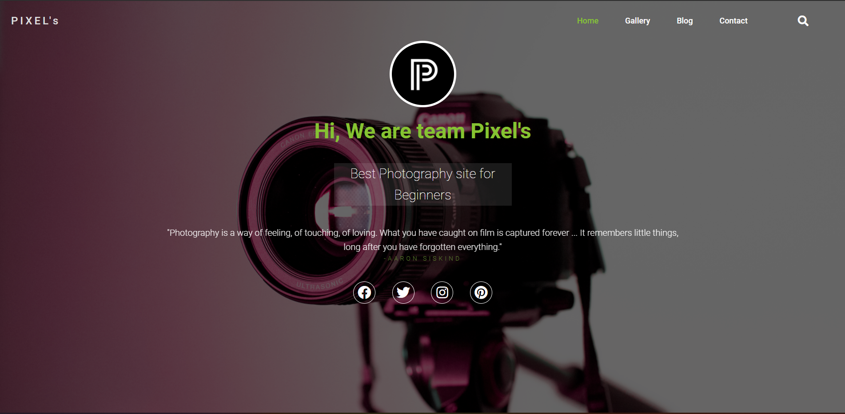
Home page: Header includes nav-bar, brand logo, and social media ref.

Slide 12
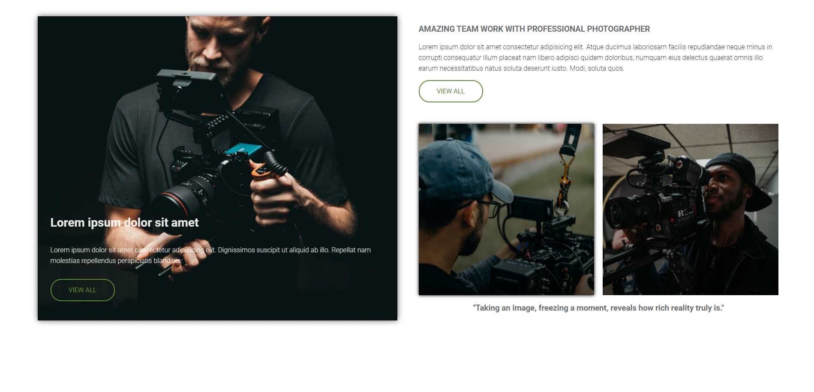
Home page: body includes Articles, recent post’s, Amazing works of photographers

Slide 13
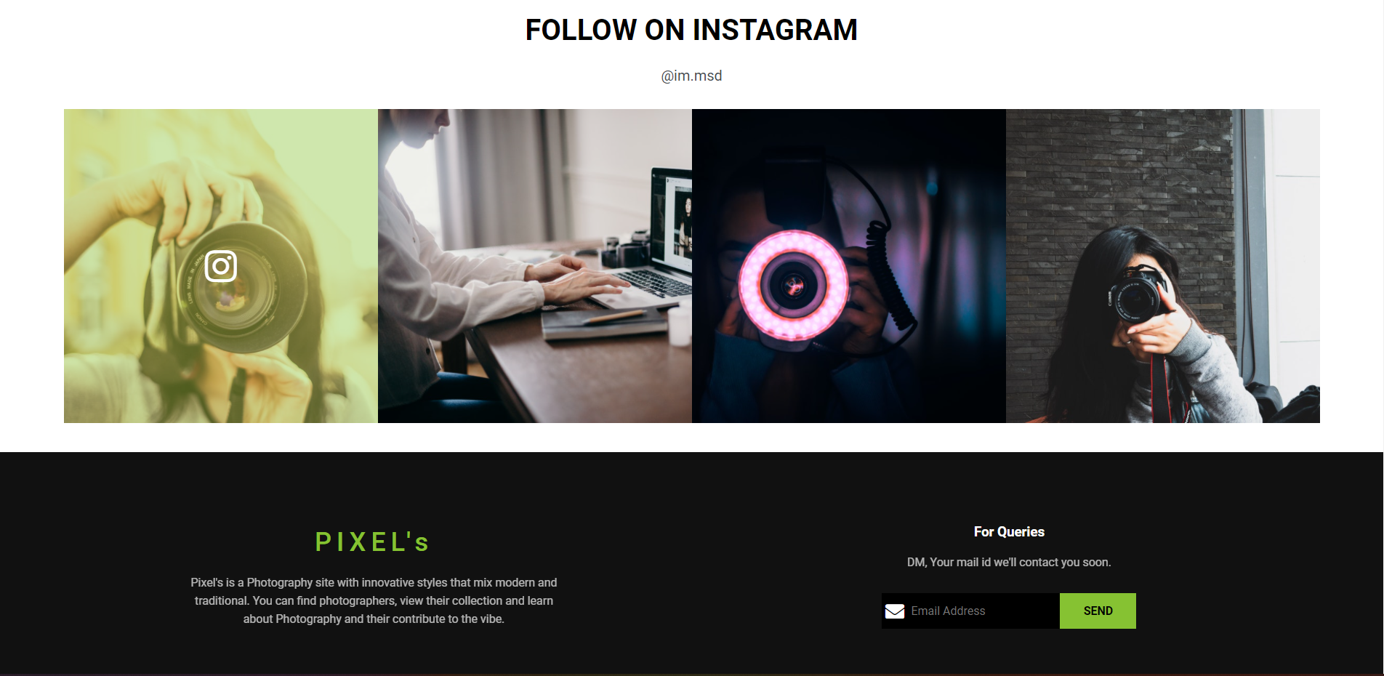
Home page: footer includes Instagram ref, pixel’s description, queries section

Slide 14
Pixel’s Gallery-page

Slide 15
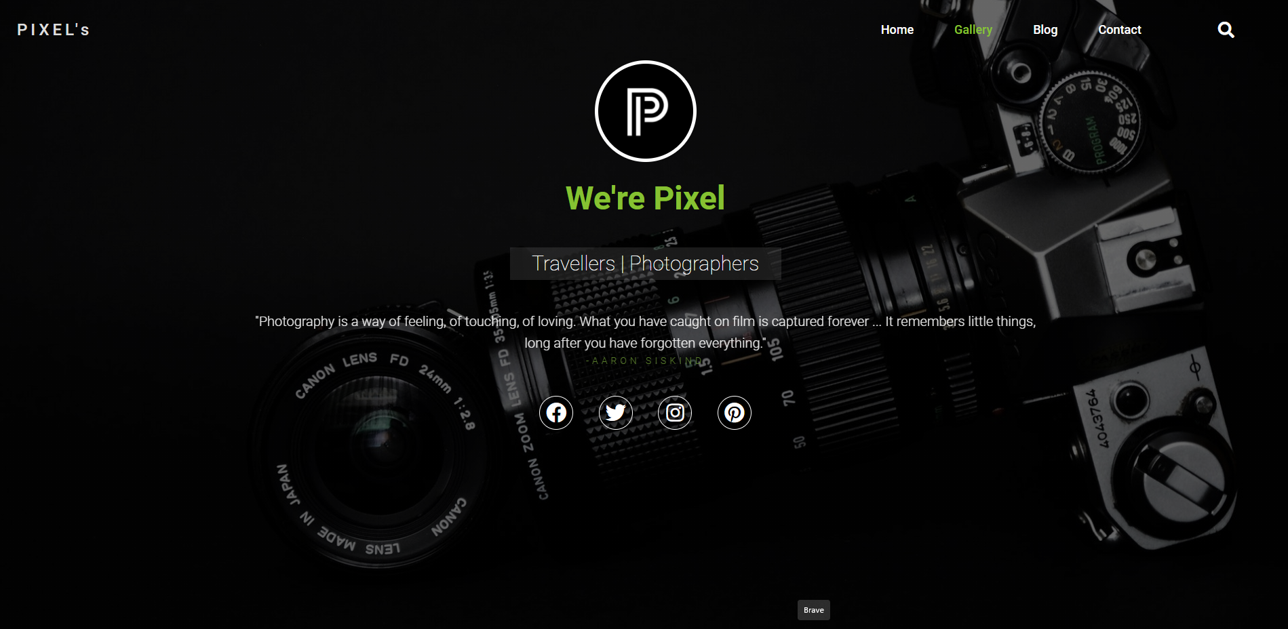
Gallery page: Header includes nav-bar, brand logo, and social media ref.

Slide 16
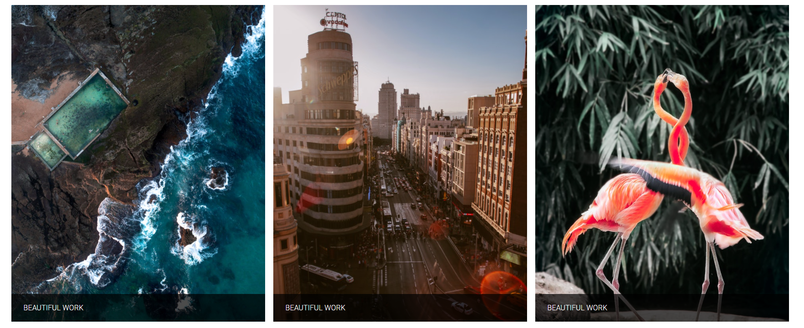

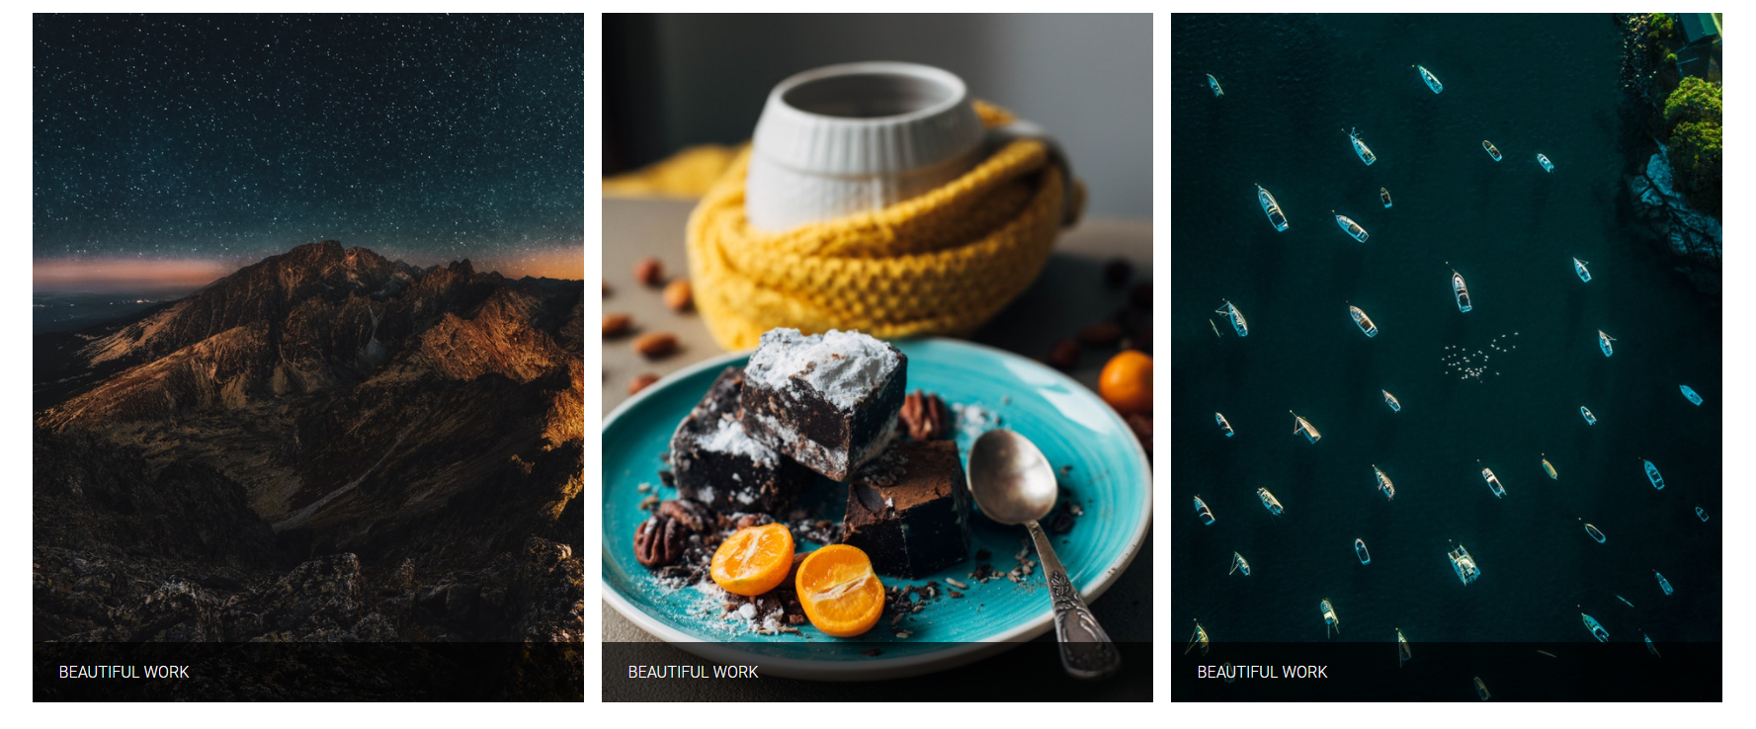
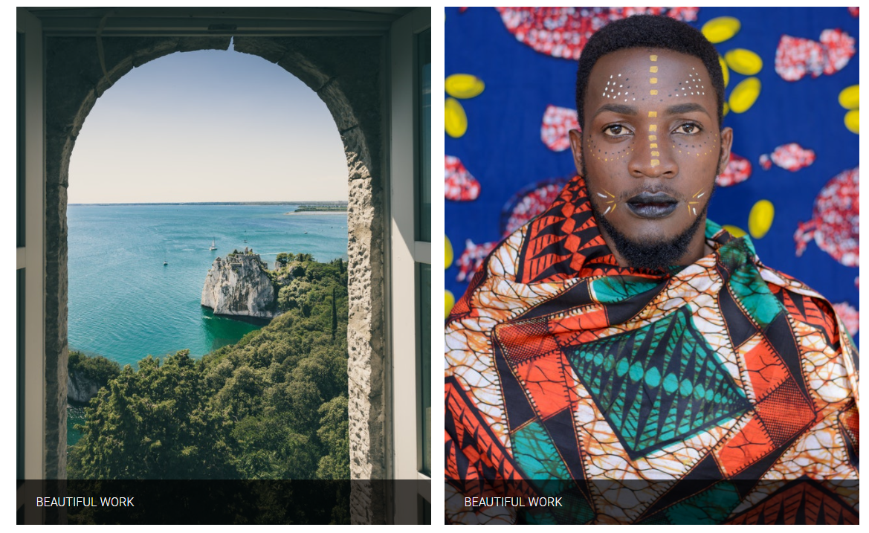
our Gallery

Slide 17

Gallery page: footer includes, description, account subscription

Slide 18

Blog page

Slide 19

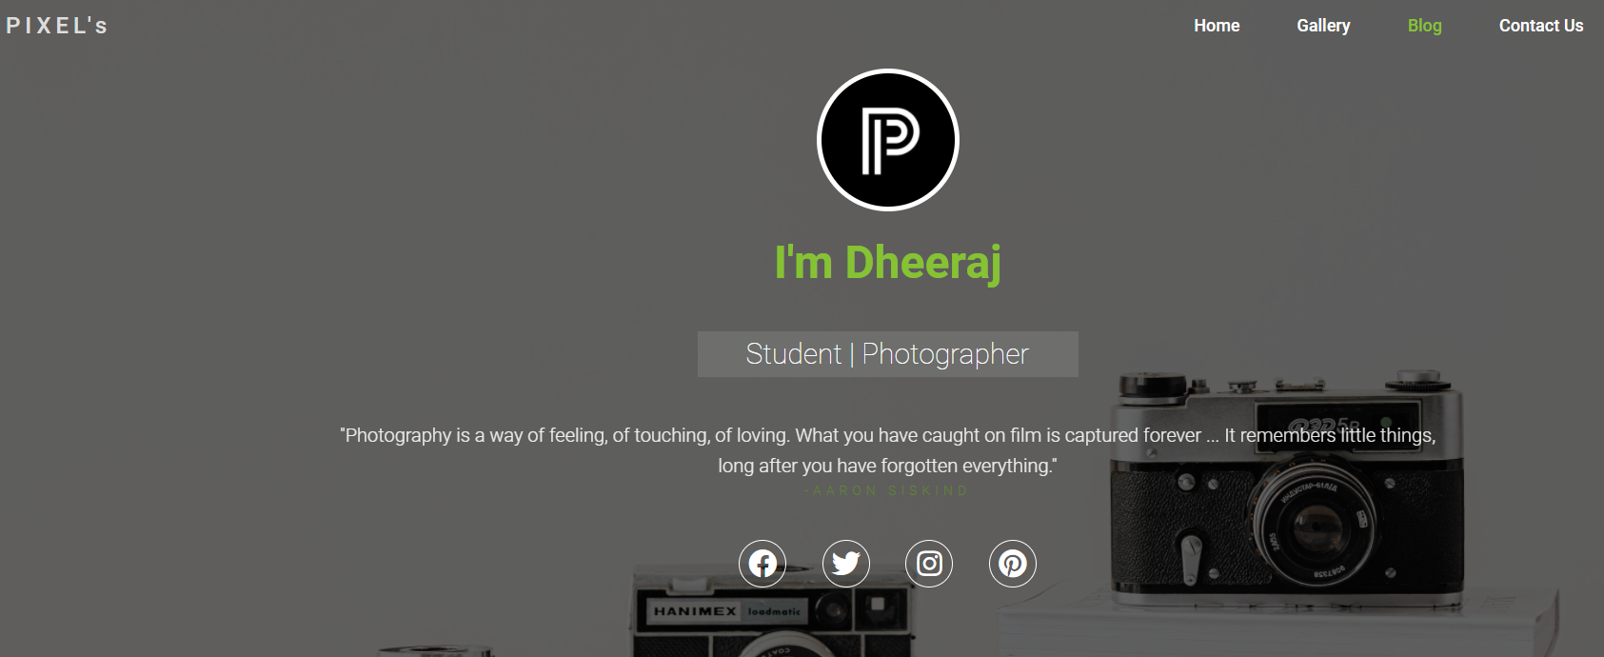
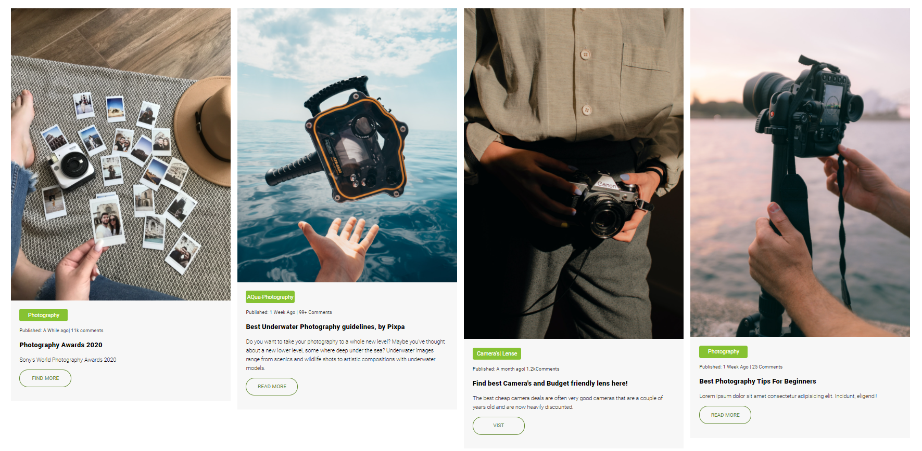

Slide 20
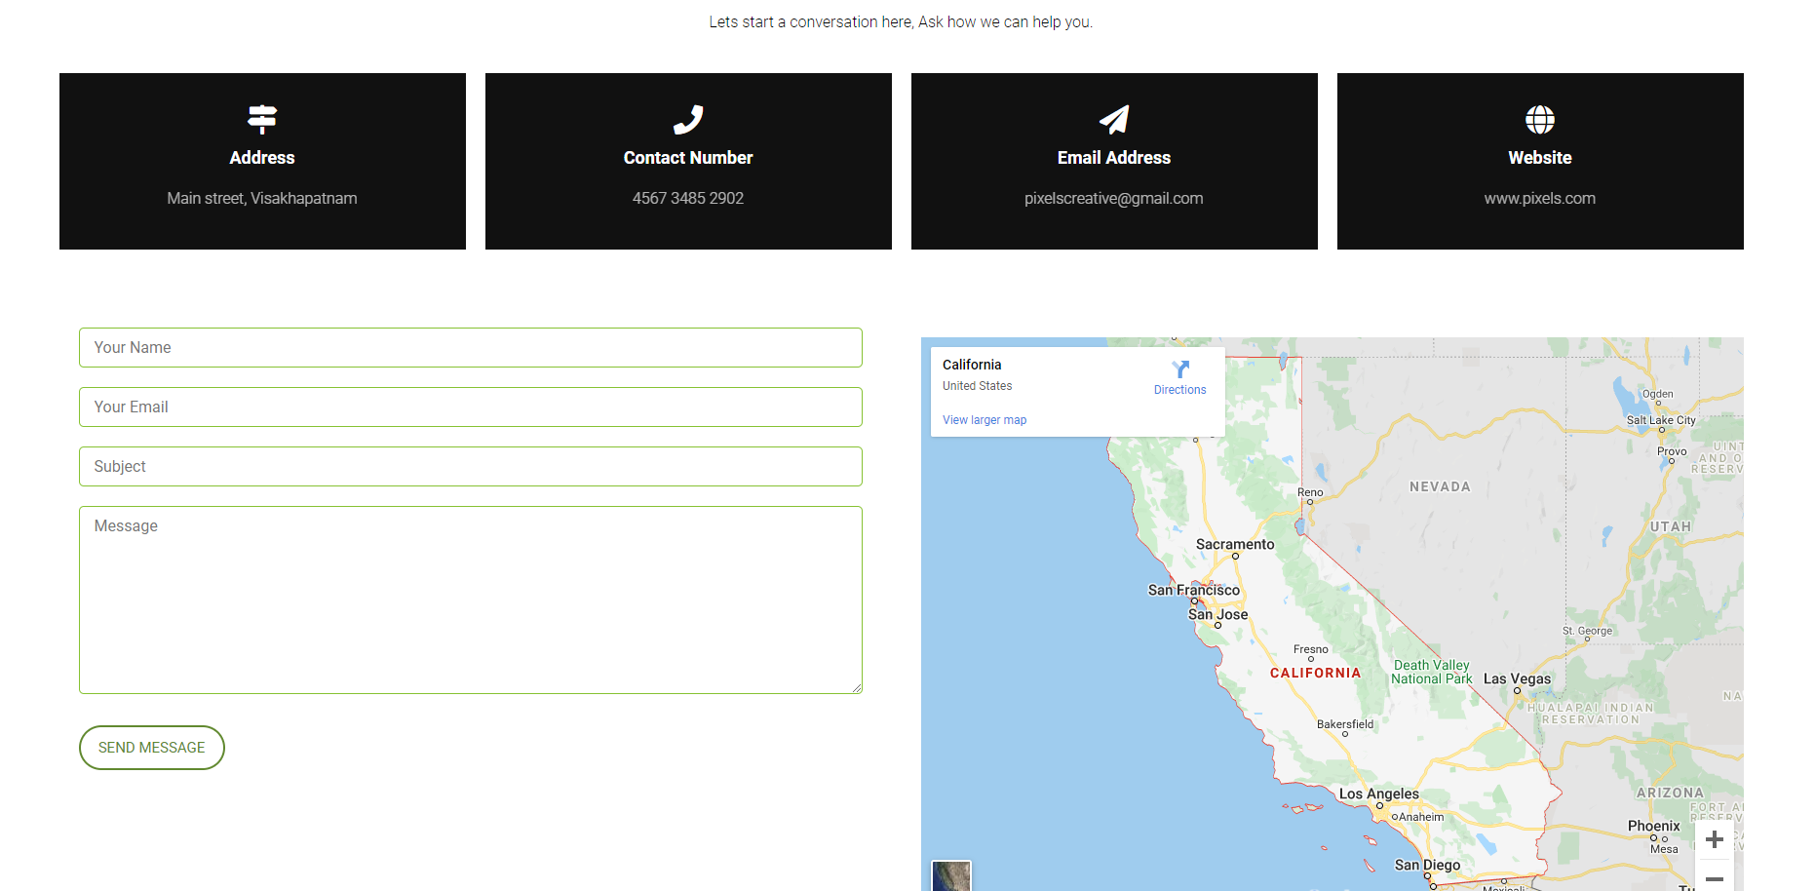
Contact us:

Slide 21
conclusion
Using PIXEL’s we can connect the world of Photography to Real World.

